Slide 1
Learning

Slide 2
Content Layout
Thorndike’s Law of Effect The Basics of Operant Conditioning Reinforcement and Punishment
Comparing classical and operant conditioning Latent Learning Observational Learning: Learning Through Imitation

Slide 3
Do you like receiving these statements?
Very good . . . What a clever idea . . . Fantastic . . . I agree . . . Thank you . . .
Excellent . . . Super . . . Right on . . . This is the best paper you’ve ever written;
you get an A . . . You are really getting the hang of it . . . I’m impressed . . .
You’re getting a raise . . . Have a cookie . . . You look great

Slide 4
Operant Conditioning
To bring about powerful changes in behavior and to teach the most complex tasks.
This is operant conditioning
Operant conditioning is the basis for many of the most important kinds of human, and animal, learning

Slide 5
Operant Conditioning
Operant conditioning is learning in which a voluntary response is strengthened or weakened, depending on its favorable or unfavorable consequences.
When we say that a response has been strengthened or weakened, we mean that it has been made more or less likely to recur regularly

Slide 6
Operant Conditioning
Unlike classical conditioning, in which the original behaviors are the natural, biological responses to the presence of a stimulus such as food, water, or pain, operant conditioning applies to voluntary responses, which an organism performs deliberately to produce a desirable outcome.
The term operant emphasizes this point:
The organism operates on its environment to produce a desirable result.
Operant conditioning is at work when we learn that toiling industriously can bring about a raise or that studying hard results in good grades.
Similar to classical conditioning, the basis for understanding operant conditioning was laid by work with animals.

Slide 7
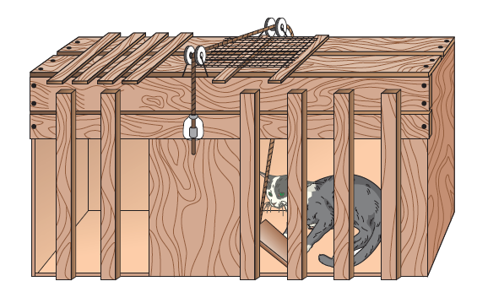
Thorndike effect
If you placed a hungry cat in a cage and then put a small piece of food outside the cage, just beyond the cat’s reach, chances are that the cat would eagerly search for a way out of the cage.

Slide 8
Cont.
Thorndike summarized that relationship by formulating the law of effect :
“Responses that lead to satisfying consequences are more likely to be repeated.”
Thorndike believed, over time and through experience the organism would make a direct connection between the stimulus and the response without any awareness that the connection existed.

Slide 9
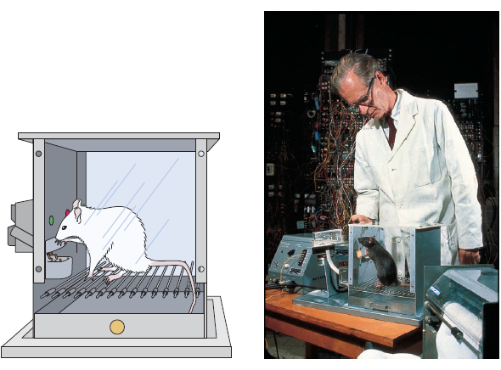
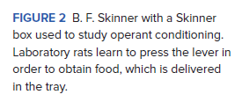
Operant Conditioning
B. F. Skinner
Skinner’s box

Slide 10
Cont.
Suppose you want to teach a hungry rat to press a lever that is in its box.
At first the rat will wander around the box, exploring the environment in a relatively random fashion.
At some point, however, it will probably press the lever by chance, and when it does, it will receive a food pellet.
The first time this happens, the rat will not learn the connection between pressing a lever and receiving food and will continue to explore the box.
Sooner or later the rat will press the lever again and receive a pellet, and in time the frequency of the pressing response will increase.
Eventually, the rat will press the lever continually until it satisfies its hunger, thereby demonstrating that it has learned that the receipt of food is contingent on pressing the lever.

Slide 11
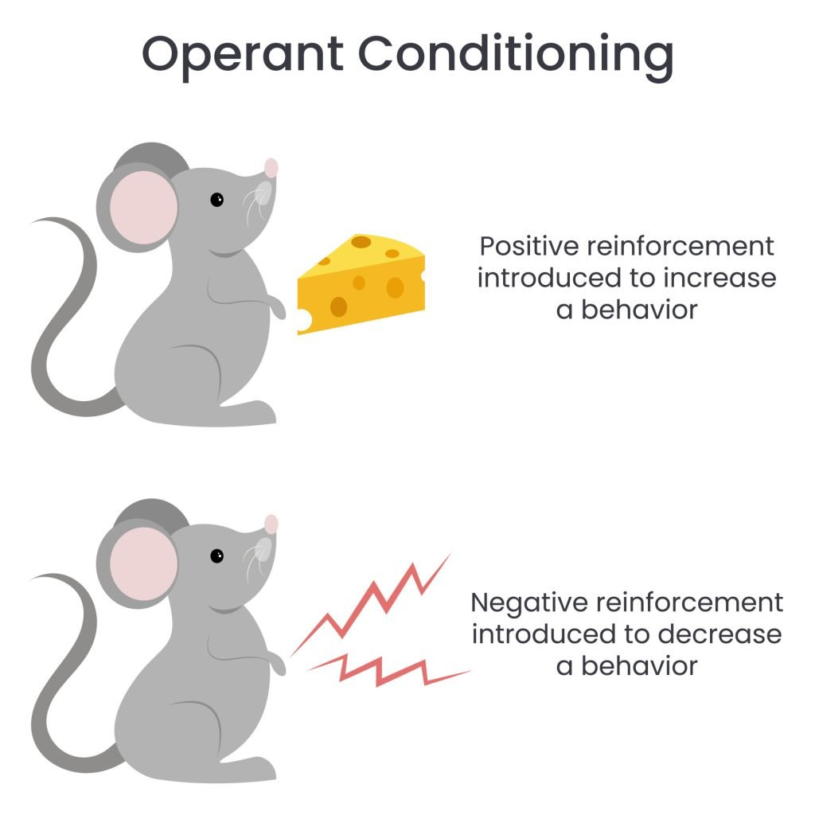
Example of operant conditioning
For example, when lab rats press a lever when a green light is on, they receive a food pellet as a reward. When they press the lever when a red light is on, they receive a mild electric shock. As a result, they learn to press the lever when the green light is on and avoid the red light.

Slide 12
Reinforcement
A reinforcer is a condition in which the presentation or removal of a stimulus, that occurs after a response (behavior) and strengthens that response, or makes it more likely to happen again in the future.
Positive Reinforcement: A stimulus presented after a response that increases the probability of that response happening again.
Ex: Getting paid for good grades

Slide 13
Reinforcement
Reinforcement is the process by which a stimulus increases the probability that a preceding behavior will be repeated.
In other words, pressing the lever is more likely to occur again because of the stimulus of food.
In a situation such as this one, the food is called a reinforce.
A reinforcer is any stimulus that increases the probability that a preceding behavior will occur again.
Hence, food is a reinforcer, because it increases the probability that the behavior of pressing (formally referred to as the r e sponse of pressing) will take place.

Slide 14
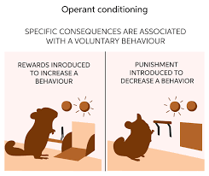
Reinforcer: Anything that increases the occurrence of a desired behavior.
Positive Reinforcement: Reinforcement by giving something.
Negative Reinforcement: Reinforcement by taking something away (removal)
Punishment: Anything that decreases the occurrence of an undesired behavior. Usually unpleasant.

Slide 15
Negative Reinforcement
Negative Reinforcement: The removal of an unpleasant or averse stimulus that increases the probability of that response happening again.
Ex: Taking Panadol to get rid of a headache.
Ex: Putting on a seatbelt to make the annoying seatbelt buzzer stop.
The word “positive” means add or apply; “negative” is used to mean subtract or remove.

Slide 16


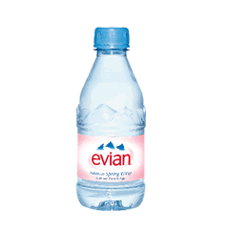
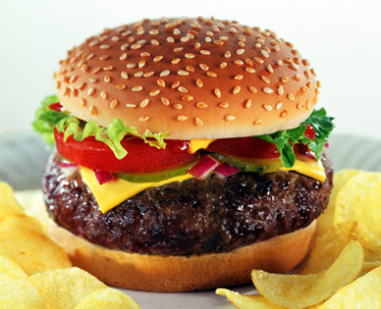
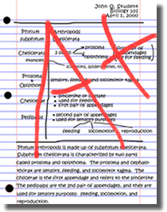
Primary and Secondary reinforcement
Primary reinforcement: something that is naturally reinforcing: food, warmth, water.
Secondary reinforcement: something you have learned is a reward because it is paired with a primary reinforcement in the long run: good grades.

Slide 17
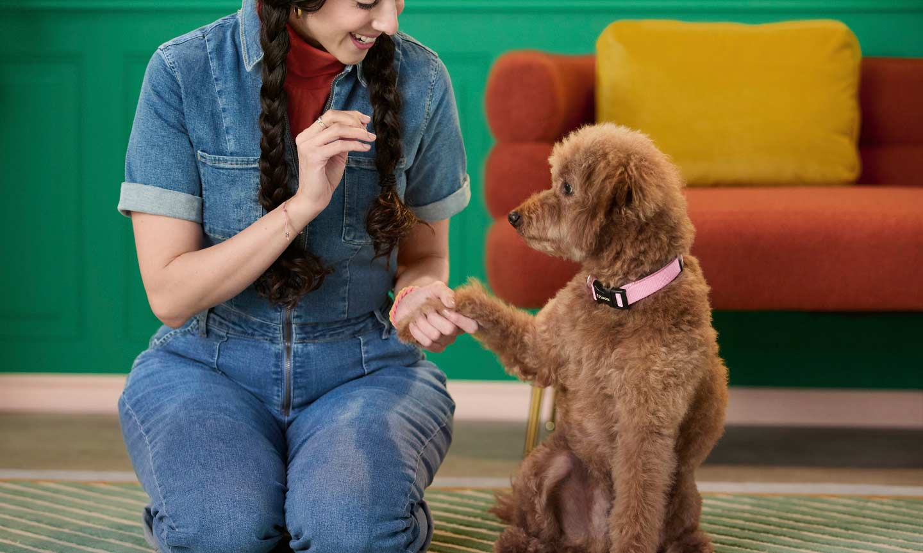
Reinforcement Example
You want to teach a dog to shake hands. One way would be to give the animal a treat every time it lifts its paws up to you. The treat is called a positive reinforcer.
Your dog will stop shaking hands when you forget to reward it for the trick as extinction will occur because the reinforcement is withheld; But will take a period of time.

Slide 18
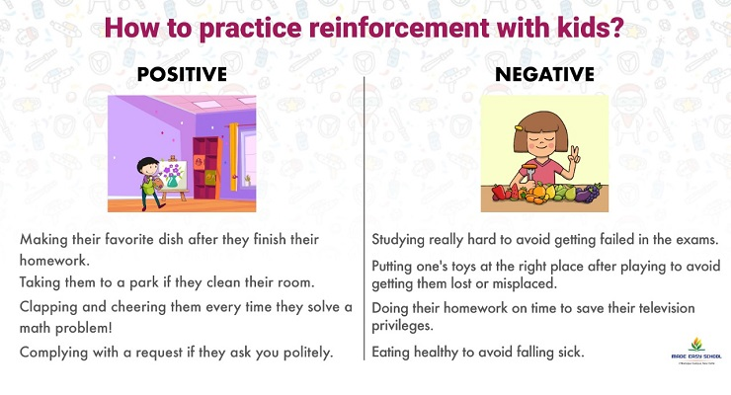

Slide 19
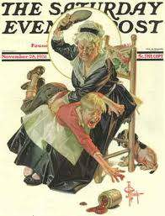
Punishment
A punishment is an averse/disliked stimulus which occurs after a behavior, and decreases the probability it will occur again.
The most obvious form of aversive control.
An unpleasant consequence occurs & decreases the frequency of the behavior that produced it.
Behavior that is punished decreases or is not repeated—that is the goal of punishment.

Slide 20
What makes a good reinforce?
What makes something a reinforcer depends on individual preferences.
Although a Hershey’s bar can act as a reinforcer for one person, an individual who dislikes chocolate may find one dollar more desirable.
The only way we can know if a stimulus is a reinforcer for a particular organism is to observe whether the frequency of a previously occurring behavior increases after the presentation of the stimulus

Slide 21
Punishment
Positive punishment: is when you add a consequence to unwanted behavior. You do this to make it less appealing.
An example of positive punishment is adding more chores to the list when your child neglects their responsibilities.
Negative Punishment: When a desirable event ends or is taken away after a behavior.
Example: getting grounded from your cell phone after failing your progress report, it is the taking away from a fun activity.
When a child misbehaves, a parent can take away a favorite toy. In this case, a stimulus (the toy) is removed in order to decrease the behavior.

Slide 22
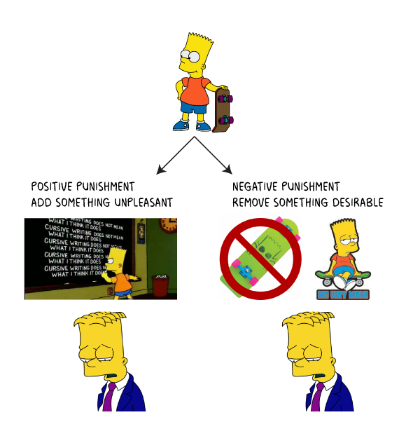

Slide 23
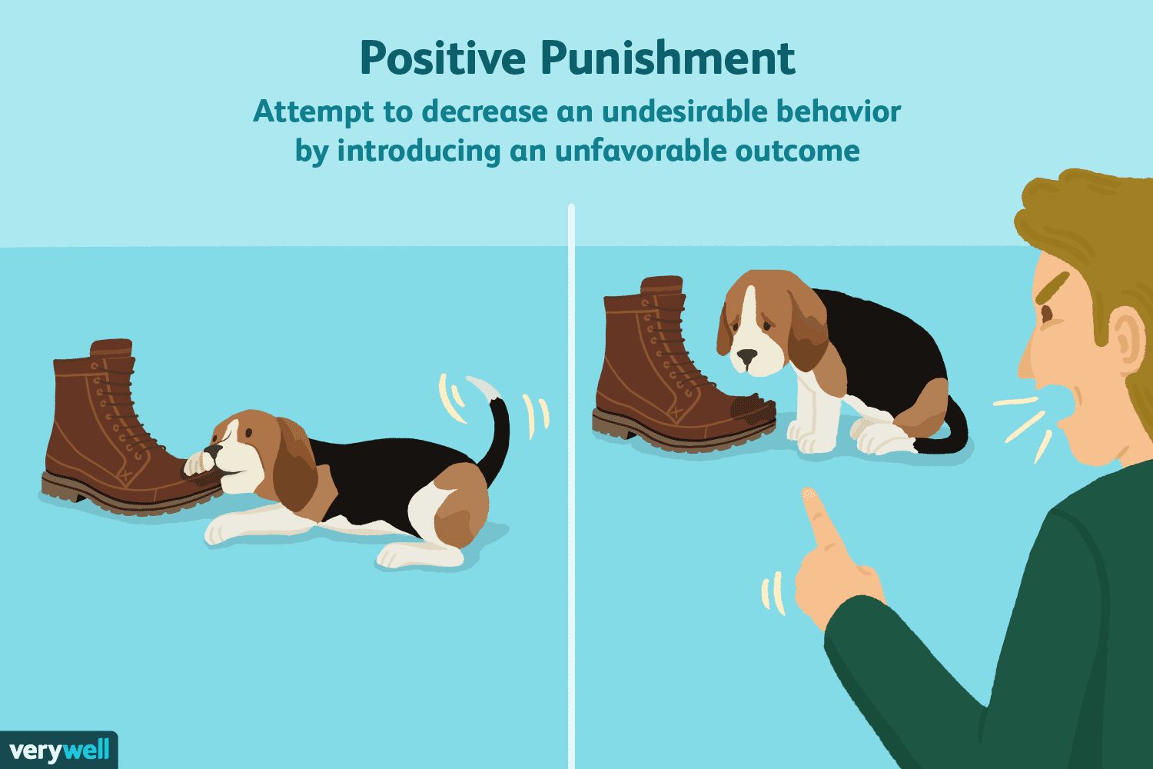
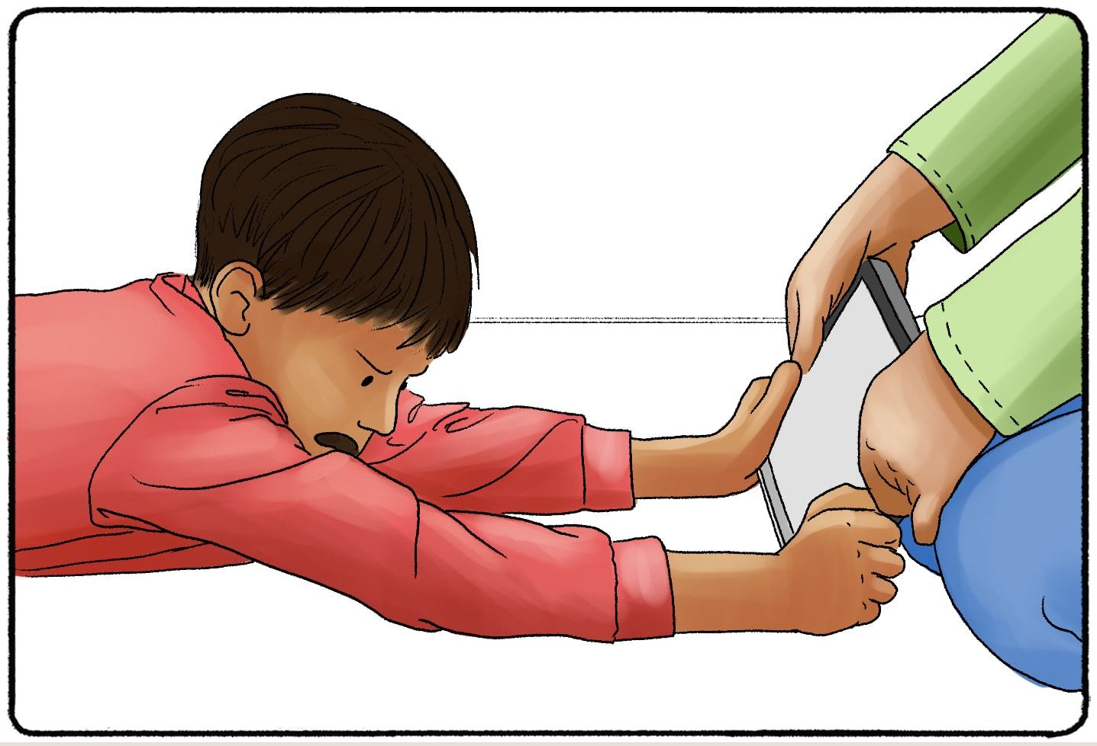

Slide 24
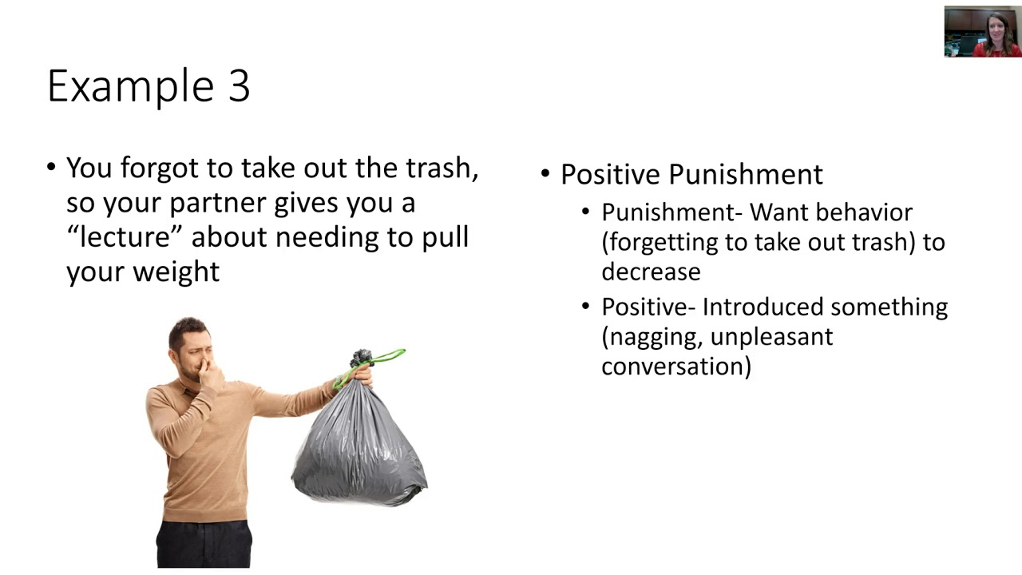

Slide 25
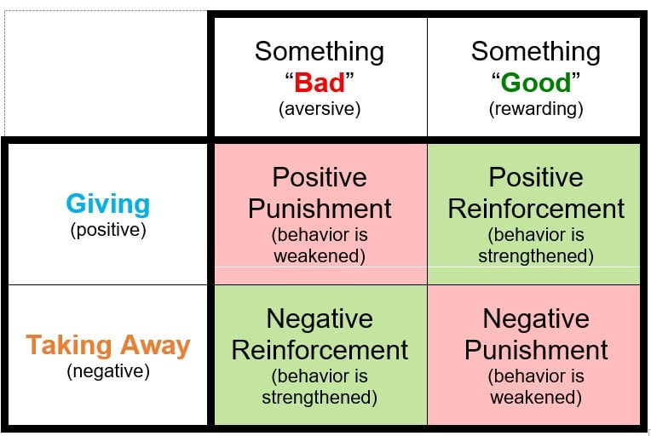

Slide 26
Punishment vs. Negative Reinforcement
Punishment and negative reinforcement are used to produce opposite effects on behavior.
Punishment is used to decrease a behavior or reduce its probability of reoccurring.
Negative reinforcement always increases a behavior’s probability of happening in the future (by taking away an unwanted stimuli).
Remember, “positive” means adding something and “negative means removing something.

Slide 27
Timing Rewards
When we refer to the frequency and timing of reinforcement that follows desired behavior, we are talking about schedules of reinforcement .
Behavior that is reinforced every time it occurs is said to be on a continuous reinforcement schedule.
If it is reinforced some but not all of the time, it is on a partial (or intermittent) reinforcement schedule .
Response to intermittent is longer than continuous. Why?

Slide 28
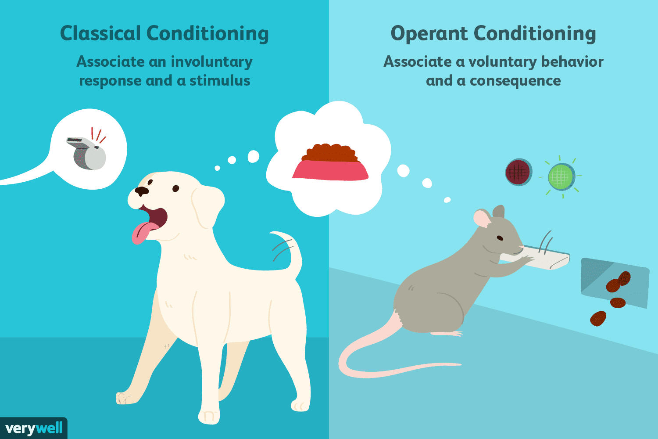
Classical vs Operant Conditioning

Slide 29
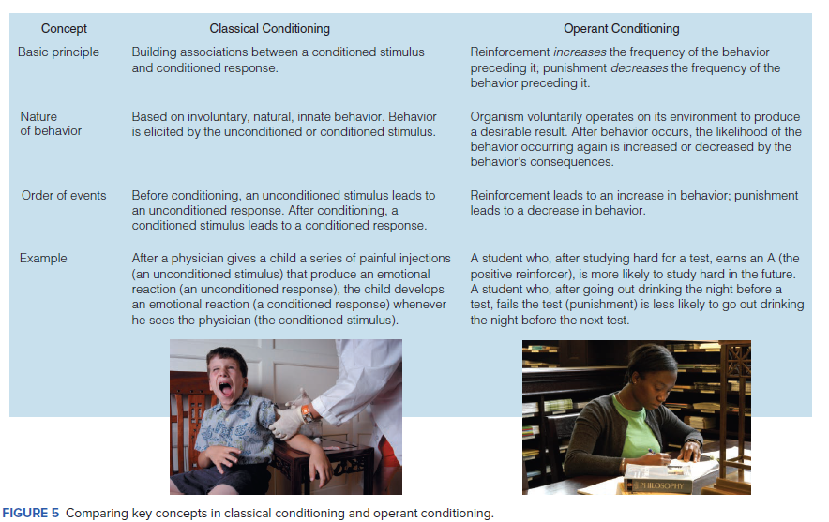

Slide 30
Observational Learning
You can think of observational learning as an extension of operant conditioning, in which we observe someone else getting rewarded but act as thought we had also received the reward.
Observational learning: Learning in which new responses are acquired after other’s behavior and the consequences of their behavior are observed.

Slide 31
Media and Violence
Does violence on TV/movies/video games have an impact on the learning of children?
Correlation evidence from over 50 studies shows that observing violence is associated with violent behavior.
In addition, experiment evidence shows that viewers of media violence show a reduction in emotional arousal and distress when they subsequently observe violent acts-a condition known as psychic numbing.

Slide 32
Albert Bandura (1997) proposed a Social Learning Theory of aggression.
Bandura (1979) believes that everyday life exposes us to aggressive models in the family, in one’s subculture, and, as we will see, in the mass media.
We learn aggression by observing others. We acquire aggression by watching others act and noting the consequences.
Physically aggressive children tend to have had physically punitive parents, who disciplined them by modelling aggression with screaming, slapping, and beating.
These parents often had parents who were themselves physically punitive. Such punitive behaviour may escalate into abuse, and although most abused children do not become criminals or abusive parents, 30 percent do later abuse their own children—four times the general population rate. Violence often begets violence.

Slide 33
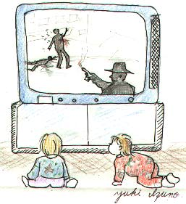
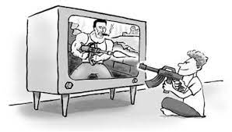
Behavior is learned from the environment through the process of observational learning. Children observe the people around them behaving in various ways. Individuals that are observed are called models. In society, children are surrounded by many influential models, such as parents within the family, characters on TV, friends within their peer group and teachers at school.

Slide 34
Bandura identified three basic models of observational learning:
A live model, which involves an actual individual demonstrating or acting out a behavior.
A verbal instructional model, which involves descriptions and explanations of a behavior.
A symbolic model, which involves real or fictional characters displaying behaviors in books, films, television programs, or online media.

Slide 35
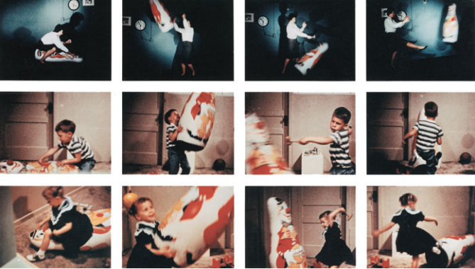
Bandura’s “Bobo Doll” Studies: Early Evidence for the Effects of Televised Violence
In these famous studies, children saw a “television program” in which an adult model either attacked an inflated plastic doll (top row of photos) or sat quietly.
When given a chance to play with the same toys, children imitated the actions of the aggressive model (bottom two rows of photos).
These findings suggested that exposure to violence in the media may lead to similar actions by viewers.

Slide 36
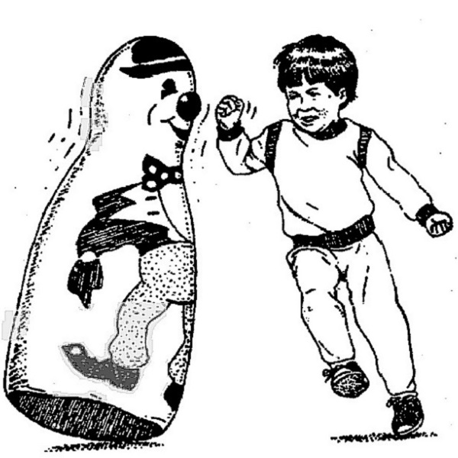
Scientific method: Can children learn to be aggressive through observational learning?
Method: Two groups of children were each shown a different short film of an adult playing with a large inflatable “Bobo” doll. In one video the adult played quietly with the doll. In the other the adult hit and kicked the doll.
Results : When children were allowed to play with the doll later, those who had seen the aggressive play were much more likely to hit and kick the doll, as they had seen the adult do.
Conclusion: Observational learning can have a powerful effect on aggression, violence and other social behaviors.

Slide 37
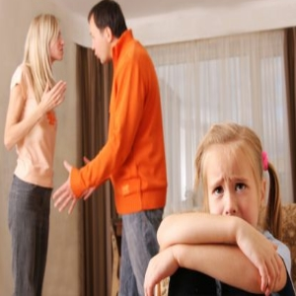

Modeling
Children learned new aggressive behaviors by observing aggressive models.
The children of aggressive parents are more likely to become aggressive parents themselves.
Studies often find that aggressive children have aggressive parents.
Daily life examples
Children learn to tie their shoes
You learn how to use utensils
What to do in any given situation
I will hurt my father because he hurt my mother.

Slide 38
Latent Learning
Learning in which a new behavior is acquired but is not demonstrated until some incentive is provided for displaying it.
People develop cognitive maps of their surroundings. For example, latent learning may permit you to know the location of a kitchenware store at a local mall you’ve frequently visited, even though you’ve never entered the store and don’t even like to cook.

Slide 39
Classroom Discipline
Reinforcing one particular behavior may actually be reinforcing the opposite behavior.
Ignoring students who misbehave in class rather than yelling at them (works most generally in the elementary level).
Peer approval= more powerful than teacher approval.

Slide 40
Improving Study Habits
Pay attention, read/recite information you have heard.
Make flash cards—USE THEM
Redo problems or questions on a lengthy assignment or test.
Make meaningful connections with the information you are learning.
Find a study partner—you haven’t mastered something until you can teach it to someone else.
Study material in small dose—not the night of the exam.

Slide 41
Improving Study Habits
Studying in a new place—free from distractions.
Don’t study too much at any one given time.
Attempt to study at the same time each day.
Set specific goals.
Tell friends not to call during study times.

Slide 42


